Slide 1
Life of a Tie
Ties (edges) have a life
  Beginning date
  Ending date
Tie dynamics (changes): 3 Processes
  Tie Formation
  Tie evolution (maintenance)
  Tie decay
Tie Formation
  Social Foci
  Preference (Choice) Homophily
  Triadic closure
  Preferential Attachment
Tie evolution

Slide 2
What about an edge can change over time?
Strength
Reciprocity
Similarity of vertices on a trait
  Influence
Embeddedness : number of common “friends”
  Clustering

Slide 3
Social Ties and Interaction Events
Tie: Link through (over) which events occur
  Through ties, events (interactions & exchanges of resources) "flow"
Directed flow: initiated event, sender (giver) and receiver
Strong ties: Large flows (number of events), bandwidth
Reciprocal ties: Balanced flows
  Balanced counts aggregated from information on the occurrence and traits of interactional events within a time window
  A temporal event sequence A->B->A->B

Slide 4
Interaction Events and Social Networks
What is a social network?
  Sets of vertices and edges: G(N,M)
  When does an edge between two vertices exist?
  Social interaction event: e_{ij}(t_{k}) = 1
    communicative interaction
Social Network Dynamics
  Temporal pattern of the interactions
  Beginning and end to a sequence of interactions

Slide 5
Dating Social Ties: Effective and Active
Begin date: time of first interaction
e_{ij}(t_{k}) = 1 | e_{ij}(t<t_{k}) = 0 for all time points t < t_{k}
End date: time of last interaction
e_{ij}(t_{k}) = 1 and e_{ij}(t>t_{k}) = 0 for all time points t > t_{k}
Left and right censoring
Active Tie:
e_{ij}(t_{k}) = 1
Effective Tie:
x_{ij}(t_{k},t_{k+∆t}) = 1 if
    e_{ij}(t) = 1 at some point in time t prior to t_{k}
    e_{ij}(t) = 1 at some point in time t after t_{k}
Effective tie implies there could be interaction between i and j at any time between t_{k} and t_{k+∆t}

Slide 6
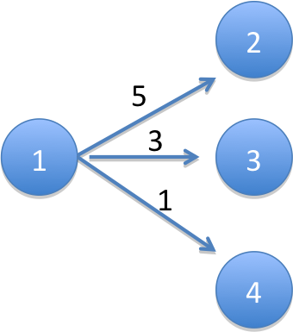
Directed Weighted Edge Graphs
Arc (x_{ij} = 1): if there was an interaction between i and j within a given time period and i initiated that interaction (e.g., a call from i to j)
Outflow Parameter (m_{ij}): Count of the number of interaction events between i and j that were initiated by i in a given time period (e.g., number of calls made by i to j)
x₁₂ = x₁₃ = x₁₄ = 1
m₁₂ = 5
m₁₃ = 3
m₁₄ = 1

Slide 7


Node Level Properties
Out-degree (d_{i}): count of number of j nodes that i has initiated interaction with in a given time period (e.g., number of people i called)
Vertex Strength (m_{i+}): activity level of a node, i.e. count of the number of interactions initiated by i with all i’s j neighbors in a given time period (e.g., total number of calls made by i)
d₁ = 3
m₁₊ = 5+3+1 = 9

Slide 8


Arc Flows & Vertex Strength
Conditional Transition Probability: Probability, given that an event has been initiated by i, that it is with j.
p₁₂ = 5/9 = .556
p₁₃ = 3/9 = .333
p₁₄ = 1/9 = .111
m₁₂ = (m₁₊) (p₁₂)
5 = 9 x (5/9)

Slide 9

Tie (Arc) Strength
Arc Flow: m_{ij} = (m_{i+}) (p_{ij})
Transition Probability: p_{ij}
Relative Strength: m_{ij}/max(m_{ik})
Vertex Strength (Activity): m_{i+}
Dyadic Edge Strength
(bandwidth)

Slide 10
Reciprocity: Simple Model
R_{ij}(1) = |m_{ij} - m_{ji}|
R_{ij}(2) = ln(m_{ij}) - ln(m_{ji}) = ln(m_{ij}/m_{ji})

Slide 11
Reciprocity: Behavioral Model
Why would j initiate interaction with i more (or less) than i initiates interaction with j?
Local knowledge:
  i knows: m_{ij}, m_{ji}, d_{i}, m_{i+}
  i does not know: d_{j}, m_{j+}
  Rij (1) & (2) assumes m_{j+} = m_{i+}, d_{j}= d_{i}
Alternative: Weight m_{ij} by m_{j+}/m_{i+}
Rij(3) = |m_{ij}(m_{j+}/m_{i+}) - m_{ji}|
Rij(4) = |ln[m_{ij}(m_{j+}/m_{i+})] - ln[m_{ji}]|
= |ln[(m_{ij}/m_{i+})/(m_{ji}/m_{j+})]|
= |ln (p_{ij}/p_{ji})|= |ln(p_{ij}) - ln(p_{ji})|
Notes:
logged means Rij = 0 when pij = pji
note if mi+ = mj+ reduces to

Slide 12
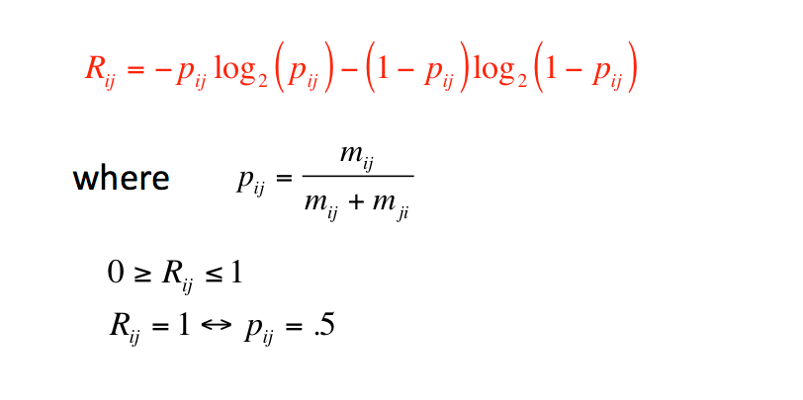
Reciprocity: Information Gain

Slide 13


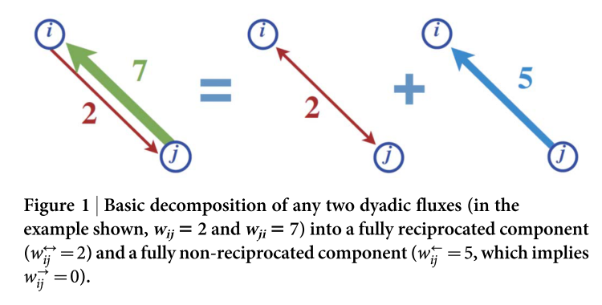
Directional Reciprocity

Slide 14
Why non-reciprocity
Given norm of reciprocity
Two explanations for non-reciprocity:
  Degree disassortativity
    A has more friends than B
  Unequal dispersion of activity among friends
    A’s ties to her friends vary in their strength

Slide 15
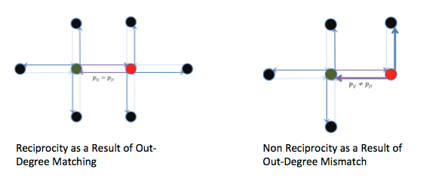
Explaining (Non-)Reciprocity
Out-Degree Mismatch

Slide 16
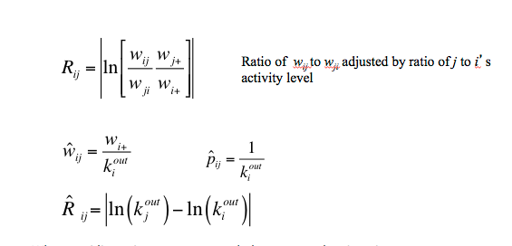
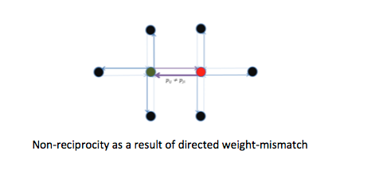
Explaining (Non-)Reciprocity
Unequal dispersion: p_{ij} ≠ p_{ik}
when equidispersion, vertex strength drops out and reciprocity a function of degree differences
degree differences --> non-reciprocity
unequal dispersion --> non-reciprocity
same degree
red vertice overdisperses

Slide 17
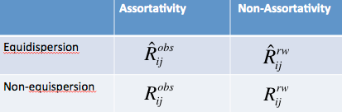
Four Variants of Reciprocity
Observed Network: Assortative & non-equidispersed
Equi-dispersed Model: Assortative & equidispersed
Rewired: Non-assortative and non-equidispersed
Rewired with Equi-dispersion

Slide 18
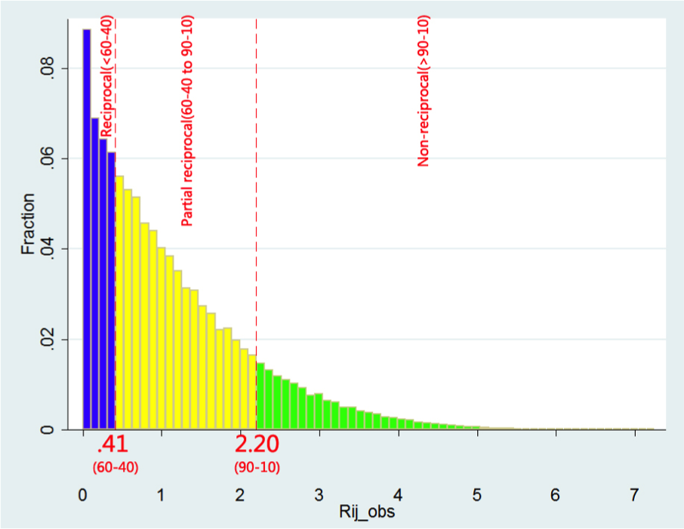
Reciprocity Distribution
27% of mutual dyads are reciprocal
58% partially reciprocal
14% non-reciprocal

Slide 19
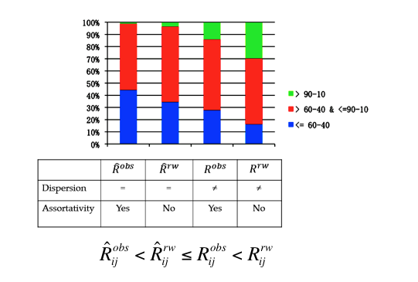
Results
Social Networks exhibit non-reciprocity because of
  degree assortativity
  unequal dispersion
Notes:
Equal disp → increases R
Assort → increases R
OBS net: uneq disp → lower R ; assort → higher R
Removes assort → lower R
Create equal disp → higher R
Best NET : equal disp and assort
Worst NET: unequal and dissassortive
Unequal dispersion more important than dissassortativity in generating non-R

Slide 20
Dynamic Dyads?
Model change over time in
  Reciprocity
  Edge strength
  Degree assortativity
Use to predict
  Change in similarity?
  Tie decay?
Life course of a tie

Slide 21
Tie and Vertex Changes
Dyad | Vertex
Tie formation & decay | Degree
Assortativity | Homophily
Strength | Av. and SD tie strength; vertex strength; Dunbar circles
Reciprocity | Av. & SD Reciprocity

